Slide 1
Endometrial injury
Nathalie Dhont

Slide 2
Theorie
Endometrial injury
lokaal inflammatoir proces →release van cytokines → verbetering implantatie en decidualisatie
Moduleert gen expressie met up regulation van pro-implantatie proteines
Meer macrophagen en dentritische cellen → verbetering implantatie

Slide 3
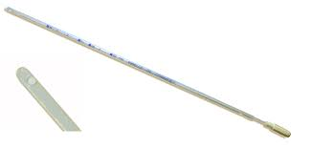
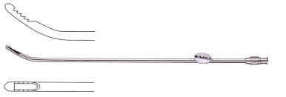
Hoe?
Pipelle
Novak curette
Hysteroscopie met of zonder biopsie

Slide 4
Wat is de evidentie
100 tal results in Pubmed
> 50 prospective trials
Cochrane review
2 recente reviews RMB online 2012

Slide 5
Recentste review en meta- analyse

Slide 6
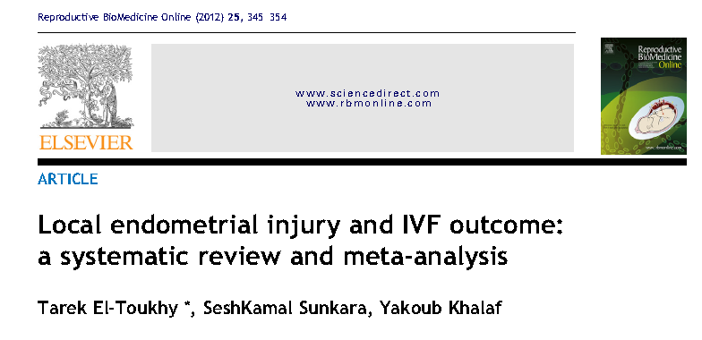

Slide 7
inclusie
 | POTDAR | EL THOUKY
Population | RIF | IVF
intervention | Scratch en/of hysteroscopie Preceding cycle | Scratch Preceding and same cycle
design | RCT of prospective | RCT/prosective/retrospective/

Slide 8
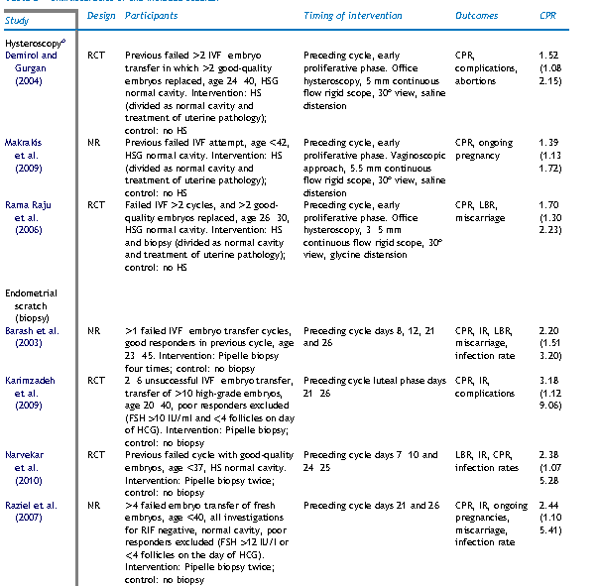

Slide 9
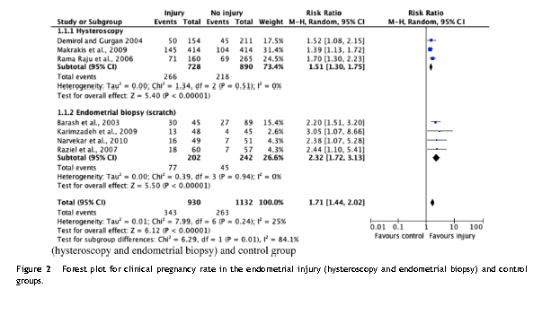

Slide 10
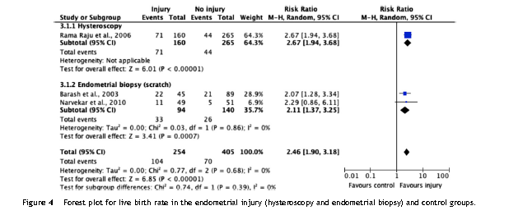

Slide 11
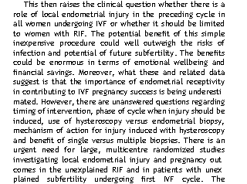

Slide 14
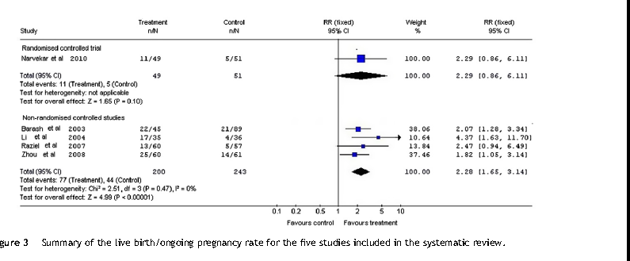

Slide 15
Twee RCTs met negatieve resultaten
Baum et al , Gynecol Endocrinol 2013
RCT
Populatie:RIF
18 : 2 pipelle curettes dag 9-12 en dag 21-24
18: cervicaal pipelle
CPR: 0% VS 31.25%_ LBR 0% VS 25% !
→geen zwangerschappen in treatment groep!

Slide 16
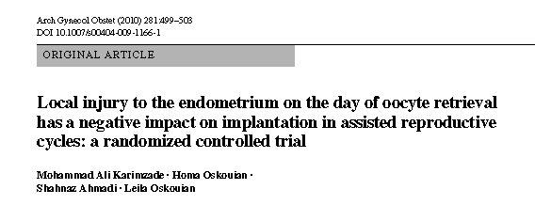
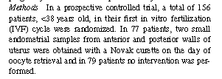

Slide 17
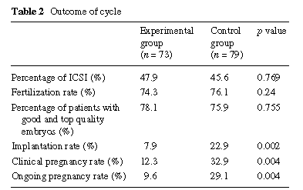

Slide 18
Recentste trials
Niet gerandomiseerd
Geen live birth rates
Geen access tot artikel
1. Clin Exp Obstet Gynecol. 2013;40(3):323-6.
Single curettage endometrial biopsy injury in the proliferative phase improves
reproductive outcome of subsequent in vitro fertilization-embryo transfer cycle
in infertile patients with repeated embryo implantation failure.
Hayashi T, Kitaya K, Tada Y, Taguchi S, Funabiki M, Nakamura Y.
IVF Center Oak Clinic, Osaka, Japan.
MATERIALS AND METHODS: Of 89 patients who repeated EIF three times following
transfer of morphologically good embryos and/or blastocysts, 40 patients chose
curettage EBI prior to the subsequent IVF-ET cycle. Using a three-mm wide
curette, EBI was performed once between days 6 and 12 of the spontaneous cycle.
Their IVF-ET outcomes in the subsequent cycle were compared with those in 49
patients who did not opt for EBI.
RESULTS: The clinical pregnancy rate (37.5% vs 12.2%), embryo implantation rate
(23.6% vs 6.3%), and ongoing pregnancy rate (25.0% vs 8.2%) were significantly
higher in the EBI group than in the non-EBI group. No serious complaints and
complications were noted.
CONCLUSION: Single curettage EBI in the proliferative phase of the preceding
cycle significantly improved IVF-ET outcome in infertile patients with repeated

Slide 19
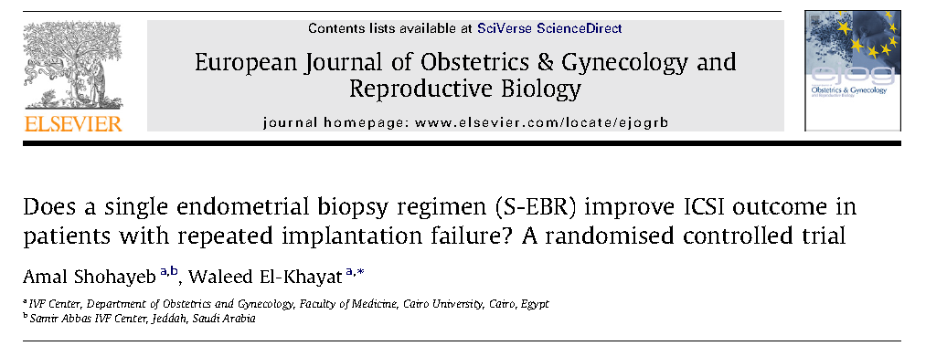
Hyscopie versus hyscopie+biospie

Slide 20
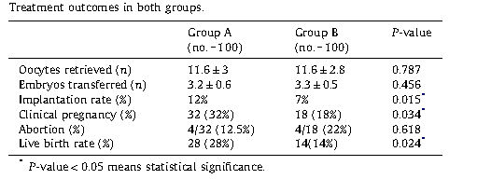
Geen controle groep
Zonder behandeling
Procedure onder narcose

Slide 21
Cochrane review

Slide 22
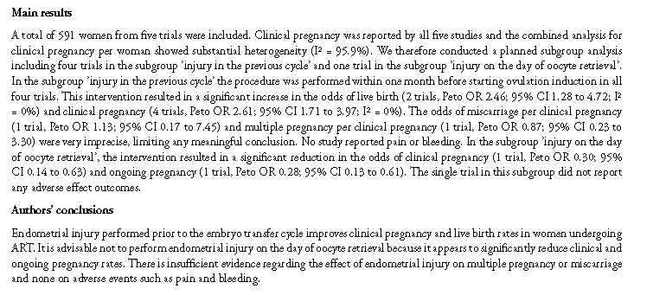

Slide 23
besluit
PRO | CONTRA
Niet duur, relatief makkelijk, weinig complicaties | pijnlijk
Groeiende evidentie (RCTS) positief effect Ook theoretisch +/- plausibel | Studies heterogeen qua studiepopulatie en procedure,relatief klein in opzet, slechts enkele LBR
 | Onbeantwoorde vragen: in welke groep? Wanneer? Met wat? Hoeveel keer?
Nood aan grote RCT Ondertussen…?

